Slide 1

Secure Data Transmission Protocol
Faculty of Engineering and Technology(Exclusively for Womens)
Department of Computer Science and Engineering
Presentation on
Under the Guidance of :
Prof. Nandini.S.Patil, Assistant Professor
Department of Computer Science and Engineering
Presented By
Priya (SW21CSE071)
Soujanya (SW21CSE096)
Kaveri (SW21CSE045)

Slide 2
Contents
Introduction
Problem Statement
Literature Survey
Objectives
Existing System
Proposed System
Methodology
Hardware and Software
Outcomes
Conclusion

Slide 3
Introduction
Vehicular Ad Hoc Networks (VANETs) represent a crucial component of Intelligent Transportation Systems (ITS), enabling vehicles to communicate with each other and with roadside infrastructure. Improper waste segregation leads to pollution and health hazards.
The aim of this project is to design and implement a secure data transmission protocol tailored specifically for VANET environments. Automating segregation increases efficiency and reduces human effort.
This project explores the design and implementation of a secure communication protocol that ensures data confidentiality, integrity, and authentication during vehicular communication.
Traditional security protocols often fall short in VANETs due to the high mobility of vehicles, rapidly changing network topologies, low latency requirements, and the need for lightweight cryptographic methods that do not overburden the system.

Slide 4
Problem Statement
Due to the high mobility of vehicles and frequent network topology changes, ensuring secure and reliable data transmission becomes a significant challenge.
One of the core challenges lies in ensuring secure and trustworthy data transmission in a highly mobile environment.
Cyberattacks such as message spoofing, replay attacks, Sybil attacks, man-in-the-middle attacks, and denial-of-service (DoS) attacks pose significant threats to VANETs.
The problem lies in developing a secure, efficient, and scalable data transmission protocol that is tailored specifically to the unique challenges and constraints of VANET environments.

Slide 5
Objectives
To Design a Secure Communication Protocol for VANETs.
To Ensure Real-Time Data Delivery with Minimal Latency.
To Preserve User Privacy While Enabling Accountability.
To Minimize Computational and Communication Overhead.
To Provide Resistance Against Common VANET Threats.

Slide 6
Literature Survey
Various studies suggest that IoT can improve waste management efficiency.
[Study 1]: Salim Salmi et al. [2] introduced lightweight and effective Intrusion
Detection Systems to identify Denial of Service attacks within WSNs.
[Study 2]: Ali Alghamdi et al. [20] proposed a convolutional technique harnessing convolutional codes to
[Study 3]: S Sundeep Desai et al. [24] proposed an autonomous node-level trust
evaluation leveraging sensor node memory, decoupled from network topology and secondary
[Study 4]:Hongyu Yang et al. [25] introduced a wireless network intrusion detection
methodology anchored in an improved CNN.

Slide 7
Existing System
Online Banking: Banks use secure data transmission to protect your financial information when you make transactions.
Protected accounts, such as Zoom, Gmail, or other widely used company accounts, are also examples of software that plays a role in a secure system.
Challenges: data might be lost during the transmission process in the network and low public awareness.

Slide 8
Proposed System
Smart waste bin with sensors to detect type of waste:
Moisture sensor → Wet Waste
Inductive proximity sensor → Metal Waste
If none → Dry Waste
Waste is dropped into the right compartment using a servo motor and controller logic.
IoT features can be added to monitor fill levels and bin status remotely.

Slide 9
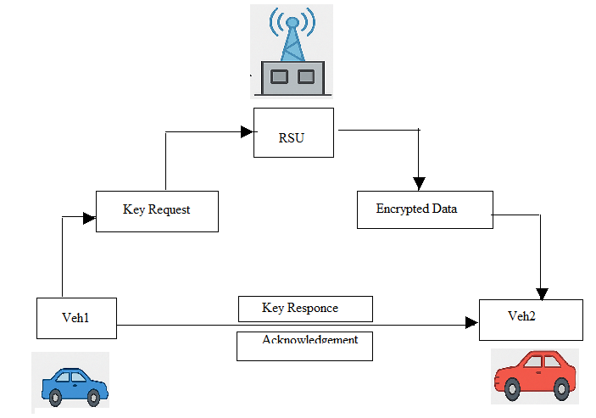
Methodology
Fig : Methodology of Secure Data Transmission Protocol.

Slide 10
• The Authentication and Identity Management Module verifies the identities of vehicles using digital certificates and manages session keys.
• The Intrusion Detection Module continuously monitors traffic to detect abnormal behaviour such as spoofing, Sybil attacks, and replay attempts.
• The Authentication Module forms the security foundation by verifying the identity of vehicles before they are permitted to transmit or receive messages.
• Dashboard for monitoring multiple bins (optional in future scope).
• Ai-based analytics for efficient waste collection (optional upgrade).

Slide 11
Hardware And Software Requirements
Software Requirements:
Front End ​​: Python
Back End ​​: SQLite3
OS ​​ : Windows 10/11
Hardware (for reference):
Processor ​​: Intel Pentium core i10
RAM ​​ : 8 GB
HDD ​​: 500 GB
Monitor ​​: Color Monitor (15”).
Peripherals ​​: Keyboard, Mouse, Multimedia Kit.

Slide 12
Expected Outcome
Ensure that devices on a network can communicate with each other effectively and accurately.
Encrypting the data and verifying the identity of the parties involved in the transmission.
To ensure that eavesdroppers and hackers are unable to see what you transmit.
Enables application programs and computing devices to exchange messages over a network.

Slide 13
Conclusion
In conclusion, the development of a Secure Data Transmission Protocol for VANET plays a crucial role in enhancing the safety, reliability, and efficiency of vehicular communication networks.
The proposed system successfully incorporates key security features such as encryption, authentication, integrity checking, and privacy preservation, all tailored to meet the dynamic and resource-constrained nature of VANET environments.
Through simulation and analysis, the protocol has demonstrated strong resilience against common security threats like spoofing, replay attacks, and message tampering, while maintaining acceptable levels of latency and computational overhead.

Slide 14
THANK YOU

